Slide 1
EE 319K
Introduction to Embedded Systems
Lecture 2: I/O, Logic/Shift Operations, Addressing modes, Memory Operations, Subroutines,
Introduction to C
Bard, Erez, Gerstlauer, Valvano, Yerraballi, Telang, Janapa Reddi, Tiwari

Slide 2
Agenda
Recap
  Embedded systems
  Product life cycle
  ARM programming
Outline
  Input/output
  Logical/shift operations
  Addressing modes, memory operations
  Stack and subroutines
  Introduction to C
    Structure of a C program
    Variables, expressions and assignments
Bard, Erez, Gerstlauer, Valvano, Yerraballi, Telang, Janapa Reddi, Tiwari

Slide 3
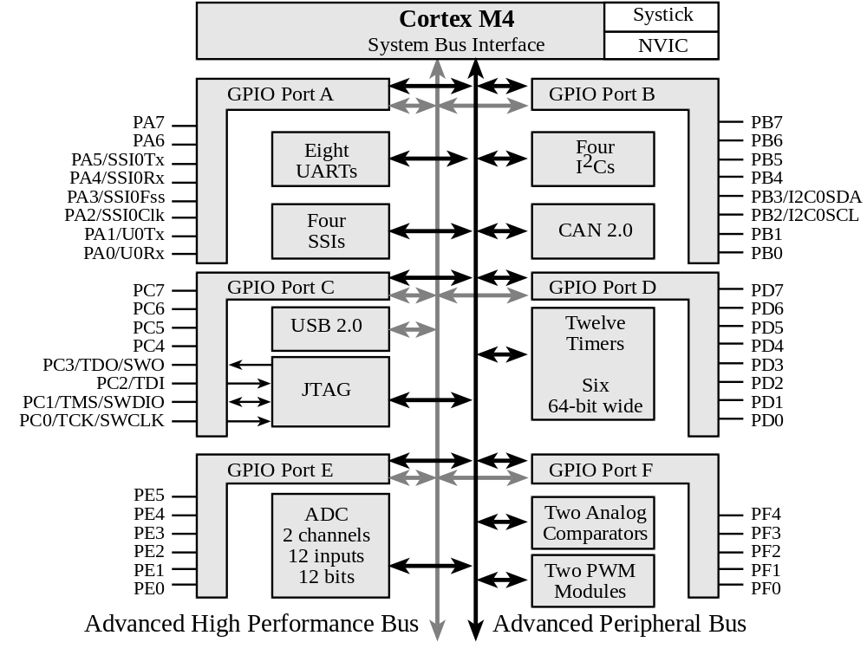
Input/Output: TM4C123
6 General-Purpose I/O (GPIO) ports:
Four 8-bit ports (A, B, C, D)
One 6-bit port (E)
One 5-bit port (F)
Bard, Erez, Gerstlauer, Valvano, Yerraballi, Telang, Janapa Reddi, Tiwari

Slide 4
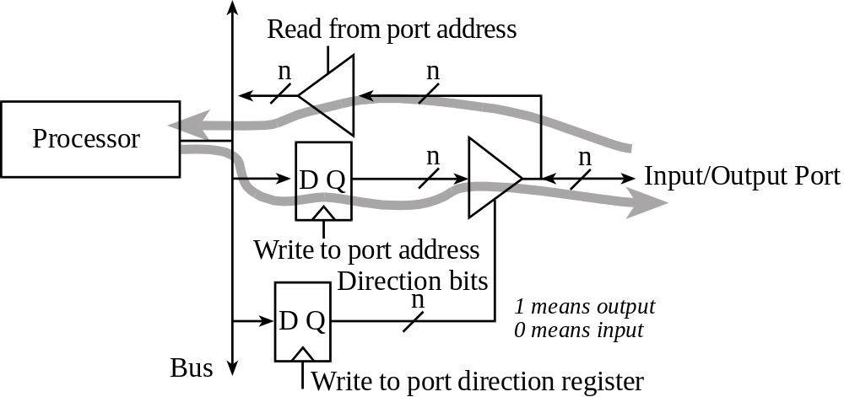
I/O Ports and Control Registers
GPIO_PORTF_DATA_R
GPIO_PORTF_DIR_R
The input/output direction of a bidirectional port is specified by its direction register.
GPIO_PORTF_DIR_R , specify if corresponding pin is input or output:
  0 means input
  1 means output
Bard, Erez, Gerstlauer, Valvano, Yerraballi, Telang, Janapa Reddi, Tiwari

Slide 5
I/O Ports and Control Registers
Address | 7 | 6 | 5 | 4 | 3 | 2 | 1 | 0 | Name
400F.E608 | - | - | GPIOF | GPIOE | GPIOD | GPIOC | GPIOB | GPIOA | SYSCTL_RCGCGPIO_R
4002.53FC | - | - | - | DATA | DATA | DATA | DATA | DATA | GPIO_PORTF_DATA_R
4002.5400 | - | - | - | DIR | DIR | DIR | DIR | DIR | GPIO_PORTF_DIR_R
4002.5420 | - | - | - | SEL | SEL | SEL | SEL | SEL | GPIO_PORTF_AFSEL_R
4002.551C | - | - | - | DEN | DEN | DEN | DEN | DEN | GPIO_PORTF_DEN_R
Initialization (executed once at beginning)
  Turn on clock in SYSCTL_RCGCGPIO_R
  Wait two bus cycles (two NOP instructions)
  Set DIR to 1 for output or 0 for input
  Clear AFSEL bits to 0 to select regular I/O
  Set DEN bits to 1 to enable data pins
Input/output from pin
  Read/write GPIO_PORTF_DATA_R
Bard, Erez, Gerstlauer, Valvano, Yerraballi, Telang, Janapa Reddi, Tiwari

Slide 6
Logic Operations
A Rn | B Operand2 | A&B AND | A|B ORR | A^B EOR | A&(~B) BIC | A|(~B) ORN
0 | 0 | 0 | 0 | 0 | 0 | 1
0 | 1 | 0 | 1 | 1 | 0 | 0
1 | 0 | 0 | 1 | 1 | 1 | 1
1 | 1 | 1 | 1 | 0 | 0 | 1
Logic Instructions
AND{S} {Rd,} Rn, <op2> ; Rd=Rn&op2
ORR{S} {Rd,} Rn, <op2> ; Rd=Rn|op2
EOR{S} {Rd,} Rn, <op2> ; Rd=Rn^op2
BIC{S} {Rd,} Rn, <op2> ; Rd=Rn&(~op2)
ORN{S} {Rd,} Rn, <op2> ; Rd=Rn|(~op2)
Bard, Erez, Gerstlauer, Valvano, Yerraballi, Telang, Janapa Reddi, Tiwari

Slide 7
To set
The or operation to set bits 1 and 0 of a register.
The other six bits remain constant.
Friendly software modifies just the bits that need to be.
GPIO_PORTD_DIR_R |= 0x03; // PD1,PD0 outputs
Assembly:
LDR R0,=GPIO_PORTD_DIR_R
LDR R1,[R0] ; read previous value
ORR R1,R1,#0x03 ; set bits 0 and 1
STR R1,[R0] ; update
c₇ c₆ c₅ c₄ c₃ c₂ c₁ c₀ value of R1
0 0 0 0 0 0 1 1 0x03 constant
c₇ c₆ c₅ c₄ c₃ c₂ 1 1 result of the ORR
Bard, Erez, Gerstlauer, Valvano, Yerraballi, Telang, Janapa Reddi, Tiwari

Slide 8
To toggle
The exclusive or operation can also be used to toggle bits.
GPIO_PORTD_DATA_R ^= 0x80; /* toggle PD7 */
Assembly:
LDR R0,=GPIO_PORTD_DATA_R
LDR R1,[R0] ; read port D
EOR R1,R1,#0x80 ; toggle bit 7
STR R1,[R0] ; update
b₇ b₆ b₅ b₄ b₃ b₂ b₁ b₀ value of R1
1 0 0 0 0 0 0 0 0x80 constant
~b₇ b₆ b₅ b₄ b₃ b₂ b₁ b₀ result of the EOR
Bard, Erez, Gerstlauer, Valvano, Yerraballi, Telang, Janapa Reddi, Tiwari

Slide 9
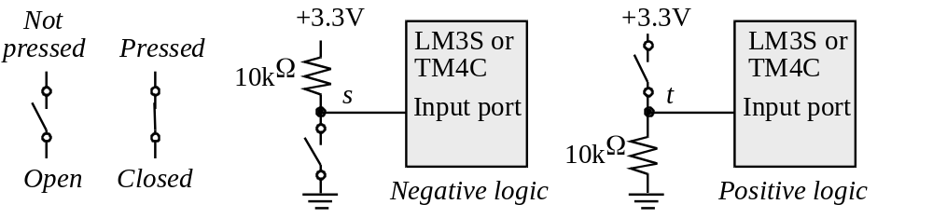
Switch Interfacing
The and operation to extract, or mask, individual bits:
Pressed = GPIO_PORTA_DATA_R & 0x10;
//true if the PA6 switch pressed
Assembly:
LDR R0,=GPIO_PORTA_DATA_R
LDR R1,[R0] ; read port A
AND R1,R1,#0x40 ; clear all bits except bit 6
LDR R0,=Pressed ; update variable
STR R1,[R0] ; true iff switch pressed
a₇ a₆ a₅ a₄ a₃ a₂ a₁ a₀ value of R1
0 1 0 0 0 0 0 0 0x40 constant
0 a₆ 0 0 0 0 0 0 result of the AND
Bard, Erez, Gerstlauer, Valvano, Yerraballi, Telang, Janapa Reddi, Tiwari

Slide 10
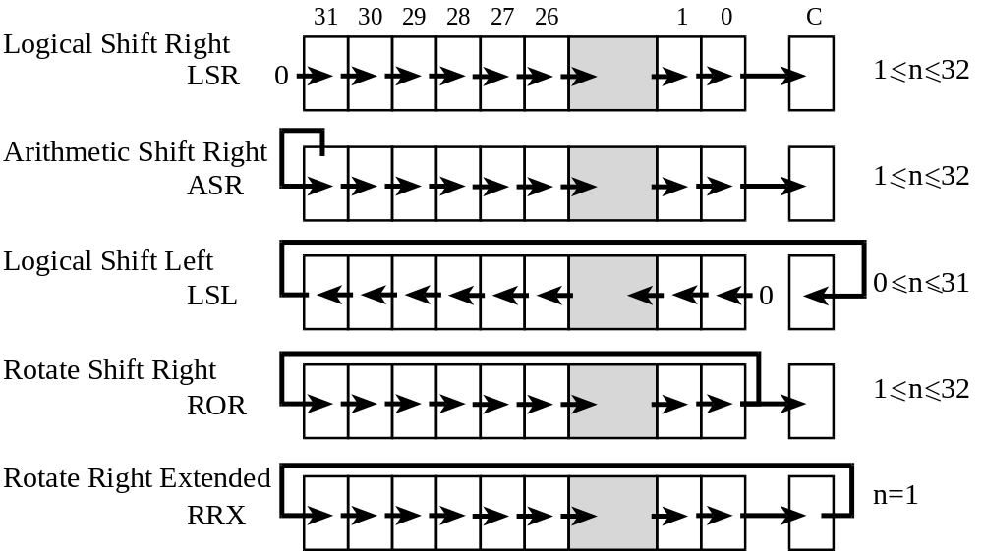
Shift Operations
Use the ASR instruction when manipulating signed numbers,
and use the LSR instruction when shifting unsigned numbers
Bard, Erez, Gerstlauer, Valvano, Yerraballi, Telang, Janapa Reddi, Tiwari

Slide 11
Shift Example
High and Low are unsigned 4-bit components, which will be combined into a single unsigned 8-bit Result.
Result = (High<<4)|Low;
Assembly:
LDR R0,=High
LDR R1,[R0] ; read value of High
LSL R1,R1,#4 ; shift into position
LDR R0,=Low
LDR R2,[R0] ; read value of Low
ORR R1,R1,R2 ; combine the two parts
LDR R0,=Result
STR R1,[R0] ; save the answer
0 0 0 0 h₃ h₂ h₁ h₀ value of High in R1
h₃ h₂ h₁ h₀ 0 0 0 0 after last LSL
0 0 0 0 l₃ l₂ l₁ l₀ value of Low in R2
h₃ h₂ h₁ h₀ l₃ l₂ l₁ l₀ result of the ORR instruction
Bard, Erez, Gerstlauer, Valvano, Yerraballi, Telang, Janapa Reddi, Tiwari

Slide 12

Design example
Market survey, profit estimate
Overall function, specifications
Data flow (test)
Flowchart (test)
Software (test)
Simulation, prototype (test)
Build (test)
Bard, Erez, Gerstlauer, Valvano, Yerraballi, Telang, Janapa Reddi, Tiwari

Slide 13
Design
Function table (PD0 input, PD3 output)
How to test (switch input, LED output)
Draw a data flow graph
Draw a flow chart
Write pseudo code
Write assembly
Simulate
Bard, Erez, Gerstlauer, Valvano, Yerraballi, Telang, Janapa Reddi, Tiwari

Slide 14
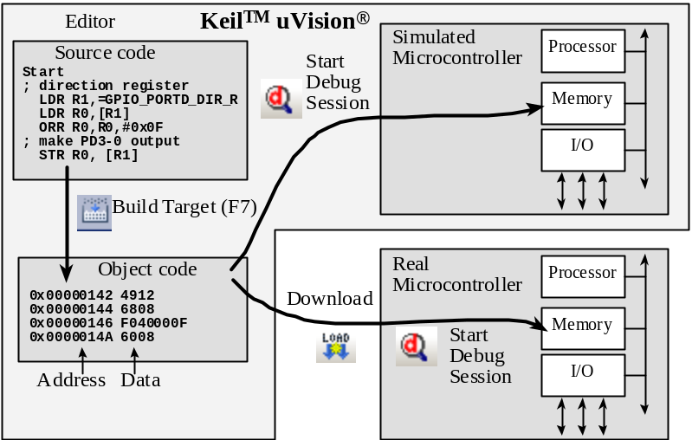
Process
Solution in NOTGate-asm.zip
Start Activate clock for port
Enable PD3, PD0 pins
Make PD0 (switch) pin an input
Make PD3 (LED) pin an output
Loop Read input from Switch (0 or 1)
not function LED = 8*(not Switch)
Write output (8 or 0)
branch Loop
Build it, run it, test it with logic analyzer
Bard, Erez, Gerstlauer, Valvano, Yerraballi, Telang, Janapa Reddi, Tiwari

Slide 15
ARM Assembly Language
Assembly format
Label Opcode Operands Comment
init MOV R0, #100 ; set table size
BX LR
Comments
  Comments should explain why or how
  Comments should not explain the opcode and its operands
  Comments are a major component of self-documenting code
Bard, Erez, Gerstlauer, Valvano, Yerraballi, Telang, Janapa Reddi, Tiwari
Notes:
What does BX LR do?

Slide 16
Simple Addressing Modes
Second operand - <op2>
  ADD Rd, Rn, <op2>
  Constant
    ADD Rd, Rn, #constant ; Rd = Rn+constant
  Shift
    ADD R0, R1, LSL #4 ; R0 = R0+(R1*16)
    ADD R0, R1, R2, ASR #4 ; R0 = R1+(R2/16)
Memory accessed only with LDR STR
  Constant in ROM: =Constant / [PC,#offs]
  Variable on the stack: [SP,#offs]
  Global variable in RAM: [Rx]
  I/O port: [Rx]
Bard, Erez, Gerstlauer, Valvano, Yerraballi, Telang, Janapa Reddi, Tiwari

Slide 17
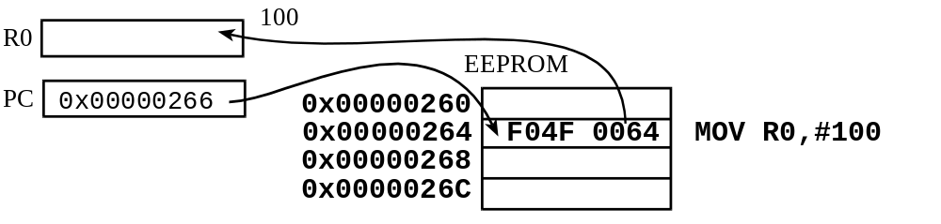
Addressing Modes
Immediate addressing
  Data is contained in the instruction
MOV R0,#100 ; R0=100, immediate addressing
Bard, Erez, Gerstlauer, Valvano, Yerraballi, Telang, Janapa Reddi, Tiwari
Notes:
List two ways to bring a constant into a register?

Slide 18
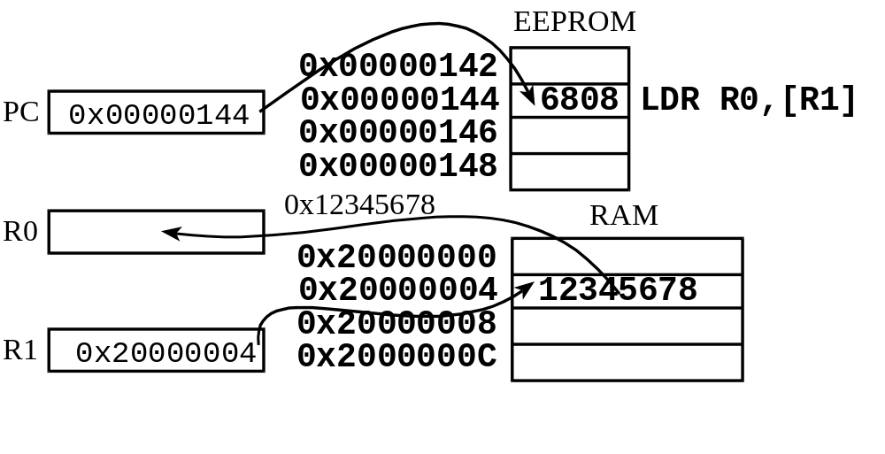
Addressing Modes
Indexed Addressing
  Address of the data in memory is in a register
LDR R0,[R1] ; R0= value pointed to by R1
Bard, Erez, Gerstlauer, Valvano, Yerraballi, Telang, Janapa Reddi, Tiwari
Notes:
Is the number 0x20000004 in general? In this example

Slide 19
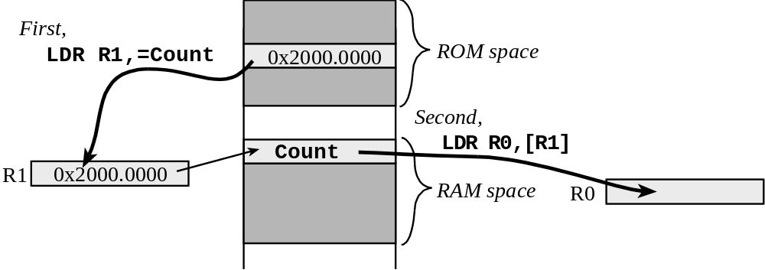
Addressing Modes
PC Relative Addressing
  Address of data in EEPROM is indexed based upon the Program Counter
Bard, Erez, Gerstlauer, Valvano, Yerraballi, Telang, Janapa Reddi, Tiwari
Notes:
The Cortex-M has a 32-bit address space
Instructions are at most 32 bits long => there is not enough space in an instruction for an address
EEPROM accesses can be indexed using the program counter
The PC always points to EEPROM and it can be used to calculate an address relative to the value in the PC
RAM accesses involve storing the address in EEPROM and then accessing it using indexed addressing relative to the PC
Two instructions will typically be required to access RAM or I/O

Slide 20
Memory Access Instructions
Loading a register with a constant, address, or data
  LDR Rd, =number
  LDR Rd, =label
LDR and STR used to load/store RAM using register-indexed addressing
  Register [R0]
  Base address plus offset [R0,#16]
Bard, Erez, Gerstlauer, Valvano, Yerraballi, Telang, Janapa Reddi, Tiwari
Notes:
ADR Rd,val is a pseudo-op that gets assembled into ADD Rd,PC,#offs
Can only load values that are addresses (relative to PC)
Offset is 8 bit, i.e. address must be within 255 bytes of PC
LDR Rd,=val is a pseudo-op that gets assembled into either a MOV Rd,#val or a constant in ROM with LDR Rd,[pc,#offs]
Can be any constant (number/value) or address

Slide 21
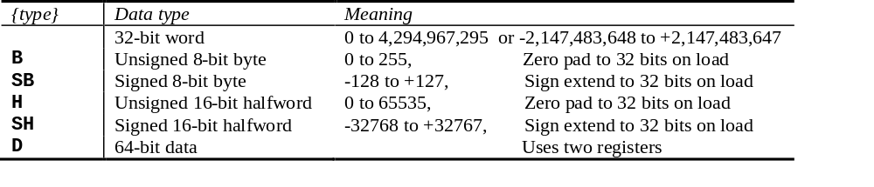
Load/Store Instructions
General load/store instruction format
LDR{type} Rd,[Rn] ;load memory at [Rn] to Rd
STR{type} Rt,[Rn] ;store Rt to memory at [Rn]
LDR{type} Rd,[Rn, #n] ;load memory at [Rn+n] to Rd
STR{type} Rt,[Rn, #n] ;store Rt to memory [Rn+n]
LDR{type} Rd,[Rn,Rm,LSL #n] ;load [Rn+Rm<<n] to Rd
STR{type} Rt,[Rn,Rm,LSL #n] ;store Rt to [Rn+Rm<<n]
Bard, Erez, Gerstlauer, Valvano, Yerraballi, Telang, Janapa Reddi, Tiwari
Notes:
Aligned/Unaligned Memory Access
Aligned
word-aligned address is used for a word, dual word, or multiple word access, or where a halfword-aligned address is used for a halfword access
Unaligned
accessing a 32-bit object (4 bytes) but the address is not evenly divisible by 4
accessing a 16-bit object (2 bytes) but the address is not evenly divisible by 2
Unaligned access supported for the following instructions:
LDR Load 32-bit word
LDRH Load 16-bit unsigned halfword
LDRSH Load 16-bit signed halfword (sign-extend bit 15 to bits 31-16)
STR Store 32-bit word
STRH Store 16-bit halfword

Slide 22
The Stack
Stack is last-in-first-out (LIFO) storage
  32-bit data
Stack pointer, SP or R13, points to top element of stack
Stack pointer decremented as data placed on stack
PUSH and POP instructions used to load and retrieve data
Bard, Erez, Gerstlauer, Valvano, Yerraballi, Telang, Janapa Reddi, Tiwari

Slide 23
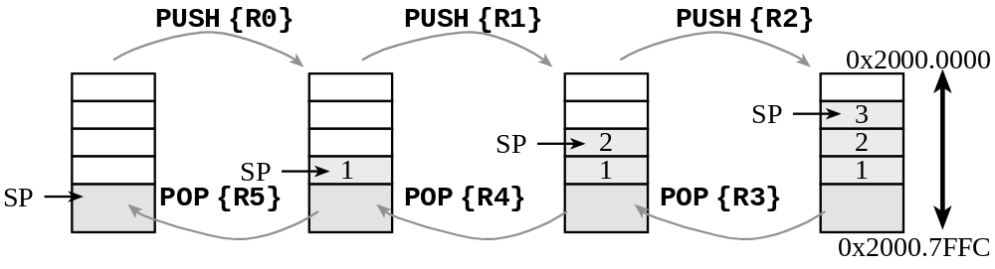
The Stack
Stack is last-in-first-out (LIFO) storage
  32-bit data
Stack pointer, SP or R13, points to top element of stack
Stack pointer decremented as data placed on stack (incremented when data is removed)
PUSH and POP instructions used to load and retrieve data
Bard, Erez, Gerstlauer, Valvano, Yerraballi, Telang, Janapa Reddi, Tiwari
Notes:
Stack push first decrements SP, then stores the data
Stack pop first reads the data, and then increments SP
Instruction sequence:
PUSH {R0}
PUSH {R1}
PUSH {R2}
POP {R3}
POP {R4}
POP {R5}

Slide 24
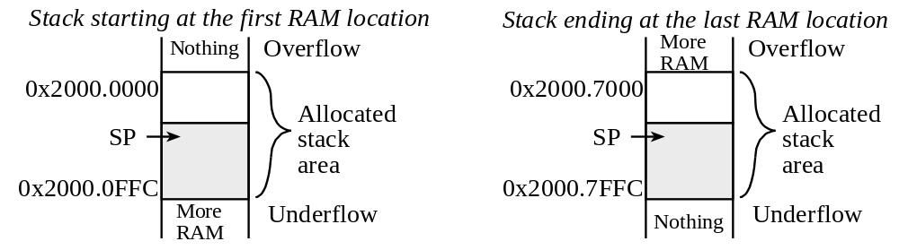
Stack Usage
Stack memory allocation
Rules for stack use
  Stack should always be balanced, i.e. functions should have an equal number of pushes and pops
  Stack accesses (push or pop) should not be performed outside the allocated area
  Stack reads and writes should not be performed within the free area
Bard, Erez, Gerstlauer, Valvano, Yerraballi, Telang, Janapa Reddi, Tiwari

Slide 25
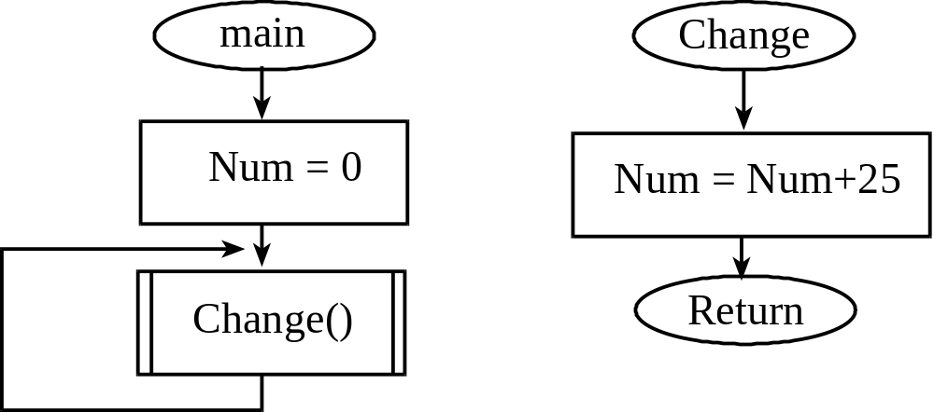
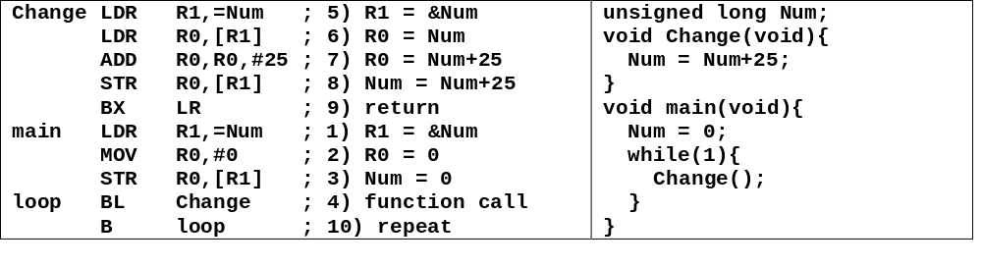
Functions
Bard, Erez, Gerstlauer, Valvano, Yerraballi, Telang, Janapa Reddi, Tiwari

Slide 26
Subroutines
;------------Rand100------------
; Return R0=a random number between
; 1 and 100. Call Random and then divide
; the generated number by 100
; return the remainder+1
Rand100
PUSH {LR} ; SAVE Link
BL Random
;R0 is a 32-bit random number
LDR R1,=100
BL Divide
ADD R0,R3,#1
POP {LR} ;Restore Link back
BX LR
;------------Divide------------
; find the unsigned quotient and remainder
; Inputs: dividend in R0
; divisor in R1
; Outputs: quotient in R2
; remainder in R3
;dividend = divisor*quotient + remainder
Divide
UDIV R2,R0,R1 ;R2=R0/R1,R2 is quotient
MUL R3,R2,R1 ;R3=(R0/R1)*R1
SUB R3,R0,R3 ;R3=R0%R1,
;R3 is remainder of R0/R1
BX LR ;return
ALIGN
END
POP {PC}
One function calls another, so LR must be saved
Bard, Erez, Gerstlauer, Valvano, Yerraballi, Telang, Janapa Reddi, Tiwari

Slide 27
Reset, Subroutines and Stack
A Reset occurs immediately after power is applied and when the reset signal is asserted (Reset button pressed)
The Stack Pointer, SP (R13) is initialized at Reset to the 32-bit value at location 0 (Default: 0x20000408)
The Program Counter, PC (R15) is initialized at Reset to the 32-bit value at location 4 (Reset Vector)
The Link Register (R14) is initialized at Reset to 0xFFFFFFFF
Thumb bit is set at Reset
Processor automatically saves return address in LR when a subroutine call is invoked.
User can push and pull multiple registers on or from the Stack at subroutine entry and before subroutine return.
Bard, Erez, Gerstlauer, Valvano, Yerraballi, Telang, Janapa Reddi, Tiwari

Slide 28
Introduction to C
C is a high-level language
  Abstracts hardware
  Expressive
  Readable
  Analyzable
C is a procedural language
  The programmer explicitly specifies steps
  Program composed of procedures
    Functions/subroutines
C is compiled (not interpreted)
  Code is analyzed as a whole (not line by line)
Bard, Erez, Gerstlauer, Valvano, Yerraballi, Telang, Janapa Reddi, Tiwari

Slide 29
Why C?
C is popular
C influenced many languages
C is considered close-to-machine
  Language of choice when careful coordination and control is required
  Straightforward behavior (typically)
Typically used to program low-level software (with some assembly)
  Drivers, runtime systems, operating systems, schedulers, …
Bard, Erez, Gerstlauer, Valvano, Yerraballi, Telang, Janapa Reddi, Tiwari

Slide 30
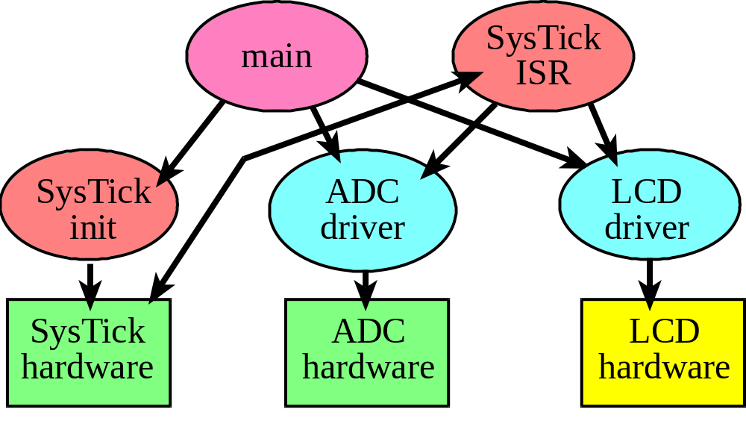
Introduction to C
Program structure
  Subroutines and functions
Variables and types
Statements
Preprocessor
DEMO
Bard, Erez, Gerstlauer, Valvano, Yerraballi, Telang, Janapa Reddi, Tiwari

Slide 31
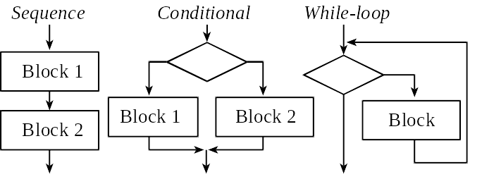
C Program (demo)
Preprocessor directives
Variables
Functions
Statements
Expressions
Names
Operators
Comments
Syntax
Bard, Erez, Gerstlauer, Valvano, Yerraballi, Telang, Janapa Reddi, Tiwari

Slide 32
Important Notes
C comes with a lot of “built-in” functions
  printf() is one good example
  Definition included in header files
  #include<header_file.h>
C has one special function called main()
  This is where execution starts (reset vector)
C development process
  Compiler translates C code into assembly code
  Assembler (e.g. built into uVision4) translates assembly code into object code
  Object code runs on machine
Bard, Erez, Gerstlauer, Valvano, Yerraballi, Telang, Janapa Reddi, Tiwari

